Slide 1

Capstone Final Project The Battle of Neighborhoods
Project Title : Recommending Location to open a new Angel coffee shop based on K-Means Algorithm
Ashwini Bhalerao

Slide 2
Introduction:
A coffee house is one of the simpler businesses to start among the food and beverage industries.
The location should be energy efficient.
This project recommends location to an entrepreneur to open a coffee shop in New York City using data science.
Whenever people want to open a new shop, they explore the place and try to fetch as much information as possible around it. It can be the neighborhood, venues, etc.,
Requested Returns features such as population rate, schools/colleges/offices around, weather conditions, recreational facilities etc.
It could make easy comparative analysis between the neighborhood with provided factors.

Slide 3
Data Section:
New York City Neighborhood Names point file from https://en.wikipedia.org/wiki/Neighborhoods_in_New_York_City
It has a total of 5 boroughs and 306 neighborhoods.
Foursquare API:
It has a database of more than 105 million places. This project would use Four-square API as its prime data gathering source.
Python Library Files:
• Pandas - Library for Data Analysis
• NumPy – Library to handle data in a vectorized manner
• JSON – Library to handle JSON files
• Folium – Map rendering Library
• Matplotlib – Python Plotting Module
• Geopy – To retrieve Location Data
• Requests – Library to handle http requests
• Sklearn – Python machine learning Library

Slide 4
Methodology
Once the neighborhood GPS data has been acquired for any given city the foursquare API call can be used to acquire the 10 most common ‘Trending’ venues around each neighborhood GPS point. The radius was set to 500m with a limit of 100 venues to be returned.
The returned venues are then grouped using a hot encoding method to display for top 5 venues for each neighborhood.
Unsupervised machine learning algorithm:
K-mean clustering would be applied to form the clusters of different categories of places in and around the neighborhoods. Each of them would be analyzed individually and comparatively to derive the best location.

Slide 5
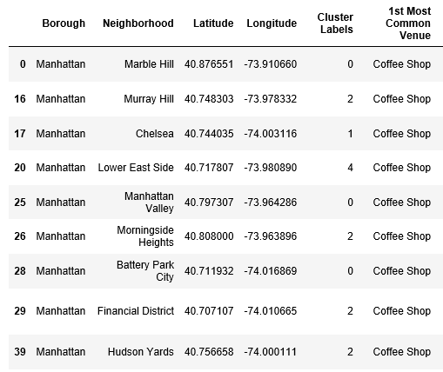
Results
The most visited/common venue is the best location for opening new shop. This model identified 9 best locations to open a new coffee shop based on input.

Slide 6
Discussion
From the results, an entrepreneur can apply this model to any city and produce a best location suggestion without any prior knowledge of the city.
The disadvantage of the this system is location suggestion not considered population density and crime rate of the city. Using other end points may be a better solution.

Slide 7
Conclusion
This model can be applied to any city where the GPS locations of a neighborhood are known. As it stands the model breaks the neighborhoods into 5 clusters of similar trending values. This model will cut down on manual research time and allow an entrepreneur to expand faster.

